Slide 1
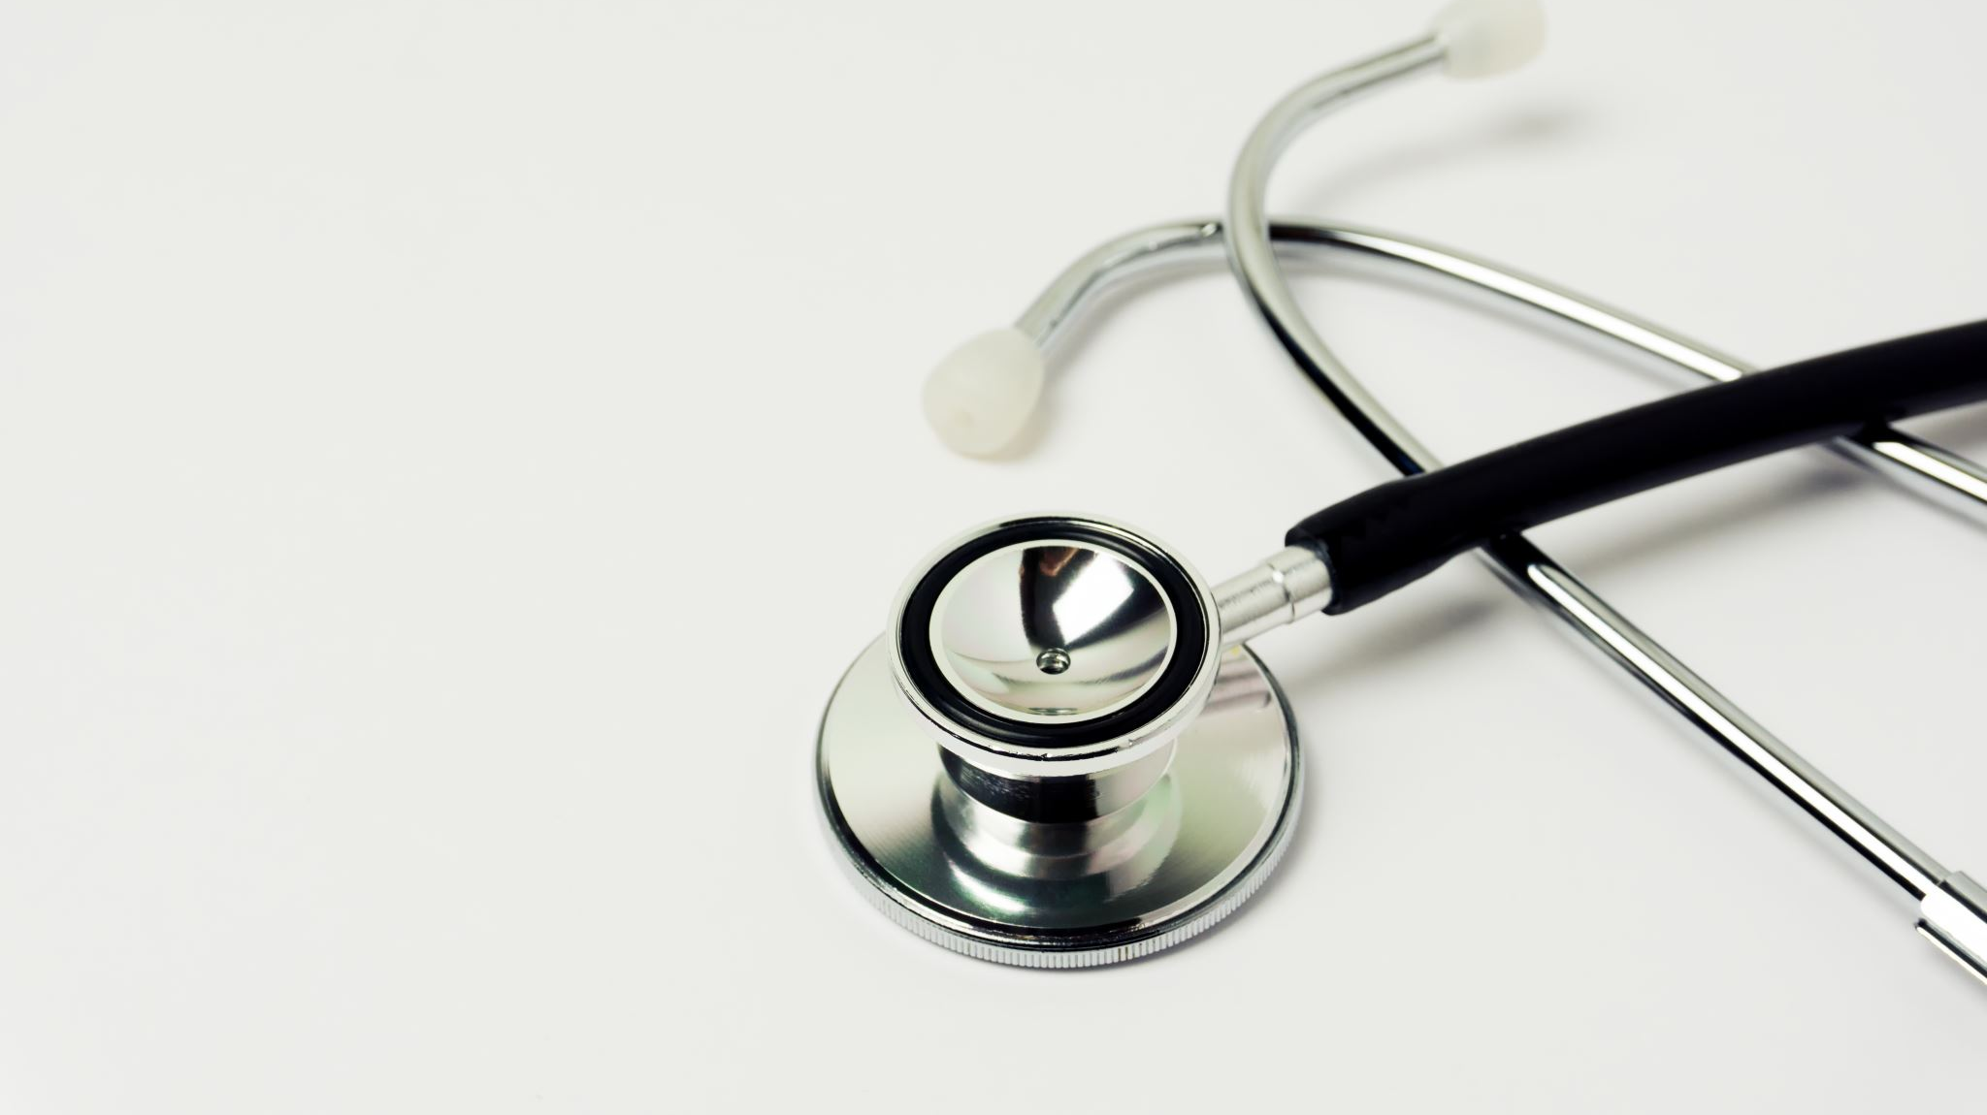
MediScan AI A comprehensive AI-powered medical diagnostic tool
Presented by: Abdullah Adel
Abdelrahman Wagih

Slide 2
Introduction
The healthcare industry faces challenges in early diagnosis, drug identification, and patient support.
Our project provides an all-in-one AI-driven medical support system.
Combines image classification, NLP, and LLM technologies.

Slide 3
Objectives
Detect pneumonia and brain tumors using deep learning.
1
Classify common over-the-counter drugs from images.
2
Perform sentiment analysis on patient reviews.
3
Provide a conversational medical chatbot using LLM.
4
Deploy the complete system with user login and Flask backend.
5

Slide 4
Technologies Used
CNN, Transfer Learning: For image classification
LSTM: For sentiment analysis
Qwen 1.8B LLM (via Olama): For chatbot responses
Flask: For backend integration
HTML/CSS/JS: For frontend
Python, TensorFlow, PyTorch, OpenCV

Slide 5
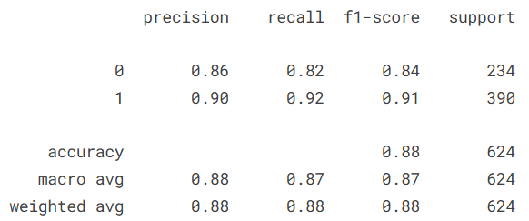
Pneumonia Detection
Upload chest X-ray image
Model classifies as “Normal” or “Pneumonia”
Trained on Kaggle X-ray dataset
I use CNN and DenseNet121 in training
You can check form her [chest]

Slide 6
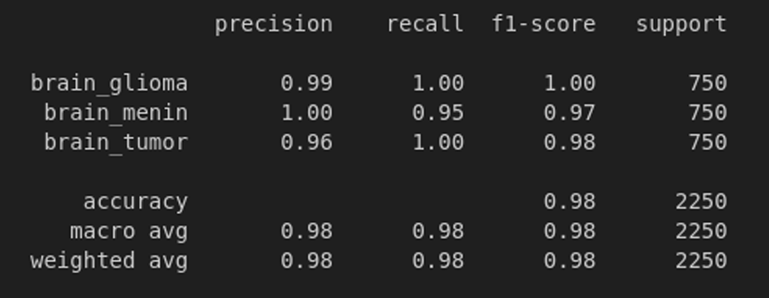
Brain Tumor Detection
Upload brain scan MRI image
Classified into:
Brain Glioma
Brain Meningioma
No Tumor
Trained using CNN + EfficientNet-B0
You can check form her [brain]

Slide 7
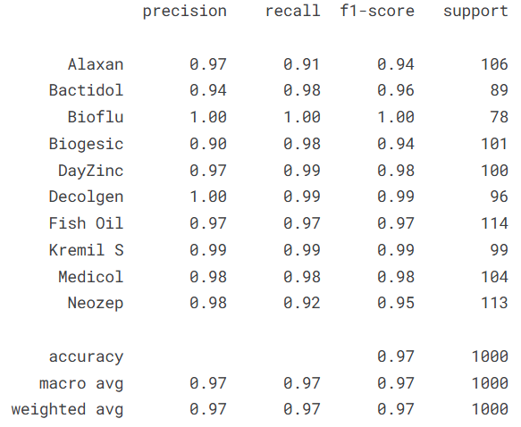
Drug Classification
Upload drug image
Classifies into 10 categories (e.g., Alaxan, Bioflu, Fish Oil, etc.)
Custom CNN model trained with data augmentation
You can check for her [Drugs]

Slide 8
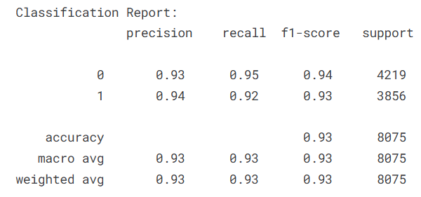
Sentiment Analysis
User writes a review of system experience
LSTM model classifies as Positive or Negative
Trained on labeled review dataset
You can check for her [sentiment-analysis]

Slide 9
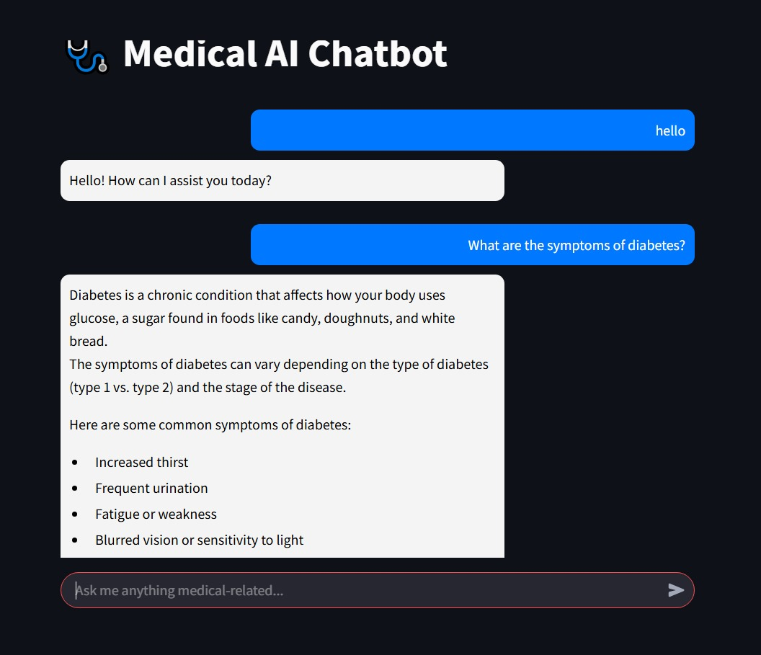
Medical Chatbot (LLM)
User types a medical question
Qwen 1.8B LLM provides a medically accurate answer
Used via Olama API

Slide 10
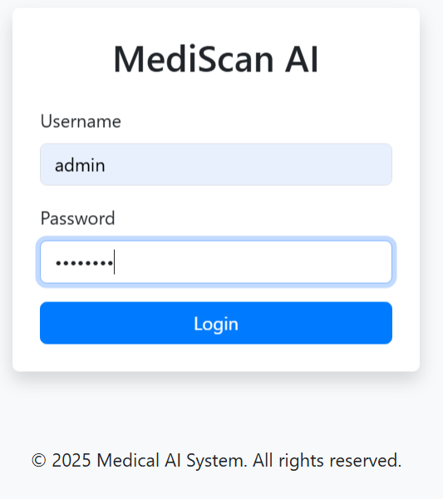
User Authentication
Login page with basic authentication
Flask-based session management

Slide 11
Deployment
Full system deployed using Flask backend
UI built using HTML/CSS
Model loaded and served locally
Secure and modular

Slide 12

System Architecture
Image uploads
Model inference
Result rendering
LLM API call for chatbot

Slide 13
Conclusion
A unified AI system for smart medical assistance
Combines deep learning, NLP, and LLM
User-friendly, fast, and extendable Demo Available on Localhost

Slide 14
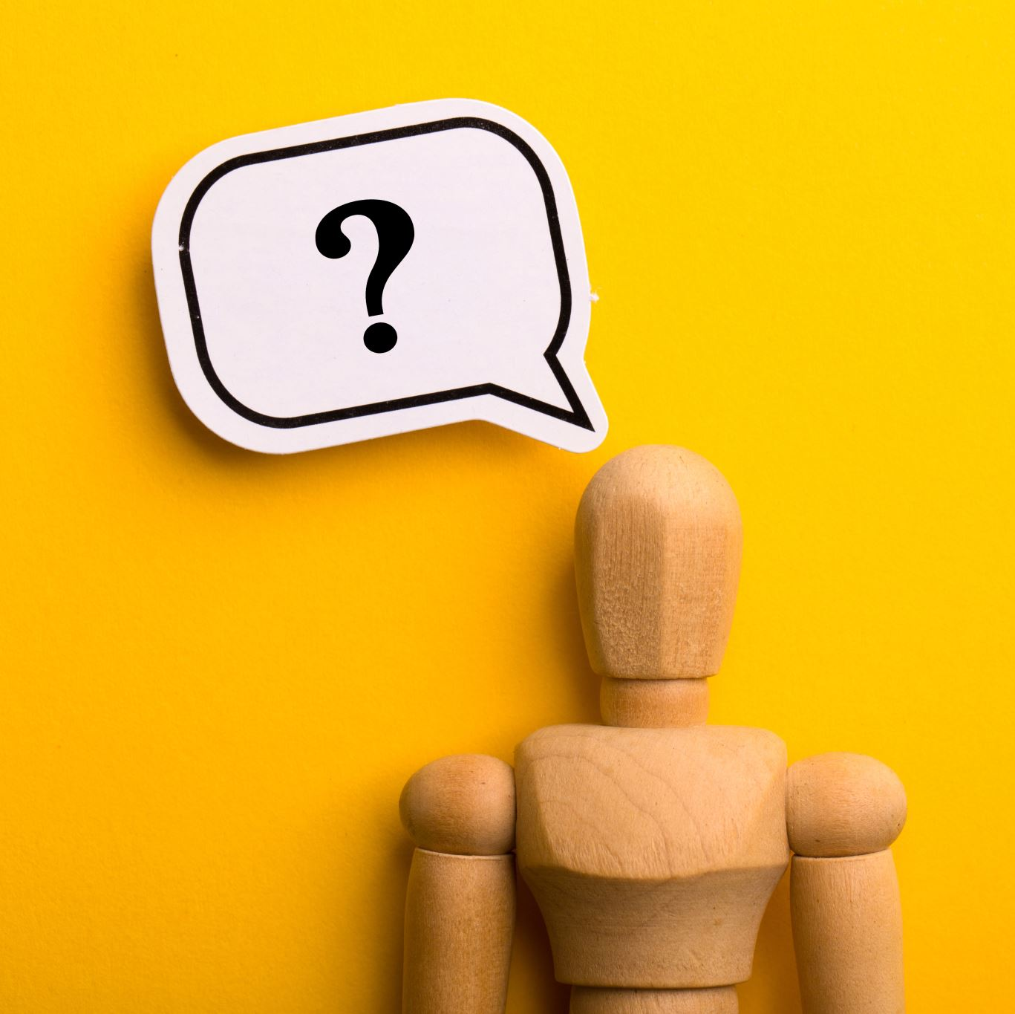
Thank You

